Slide 1


Experiment 14a
Delta-Delta Transformer –
High Resistance Grounded System
with Wye-Broken Delta transformer – Ground Fault
Dr. Norbert Doerry and Dr. John V. Amy Jr.
http://doerry.org/norbert/MarineElectricalPowerSystems/index.htm
© 2024 by Norbert Doerry and John Amy
This work is licensed via: CC BY 4.0 (https://creativecommons.org/)

Slide 2
Schematic
C_{p} = 2.2 µF
R = 1200 Ω
R_{L} = 300 Ω
N = 5.2
R_{G} = 3900 Ω
Common Mode Current Probe
Current Meter (all phases)
Voltage Meter (all phases)

Slide 3
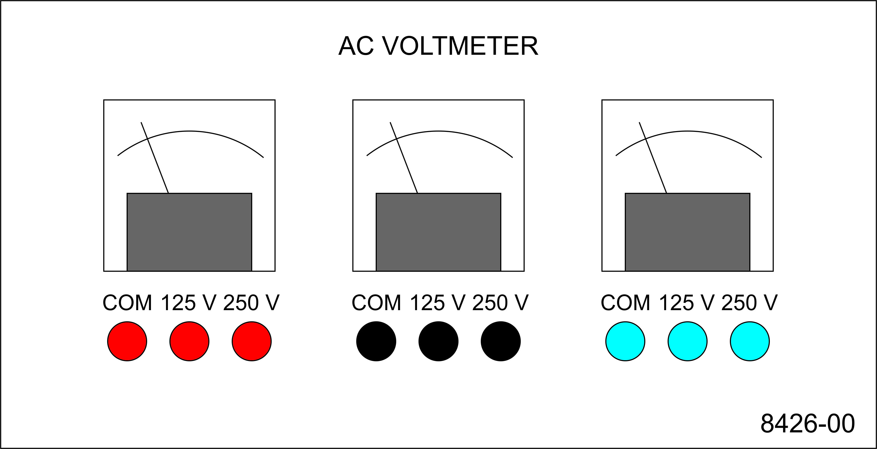
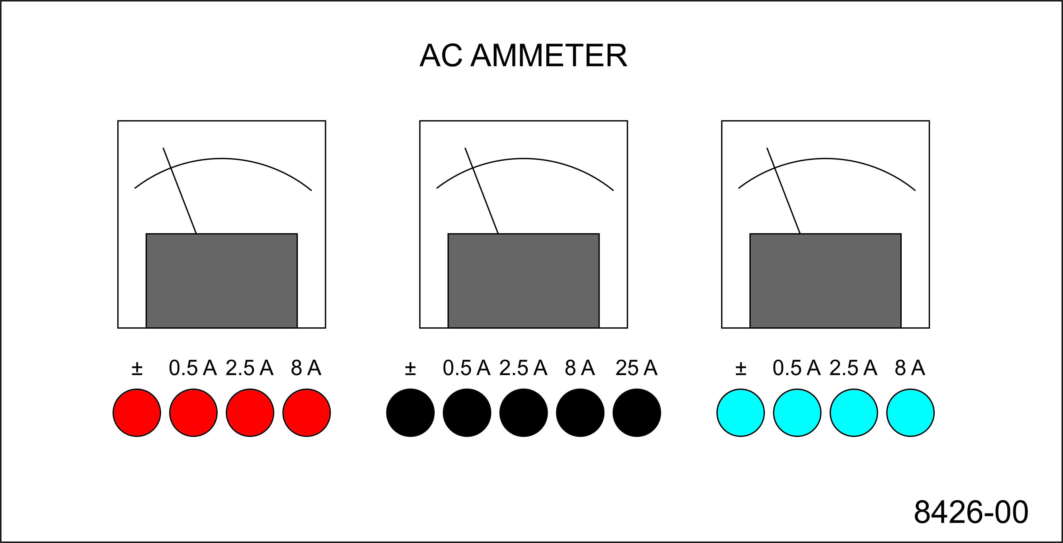
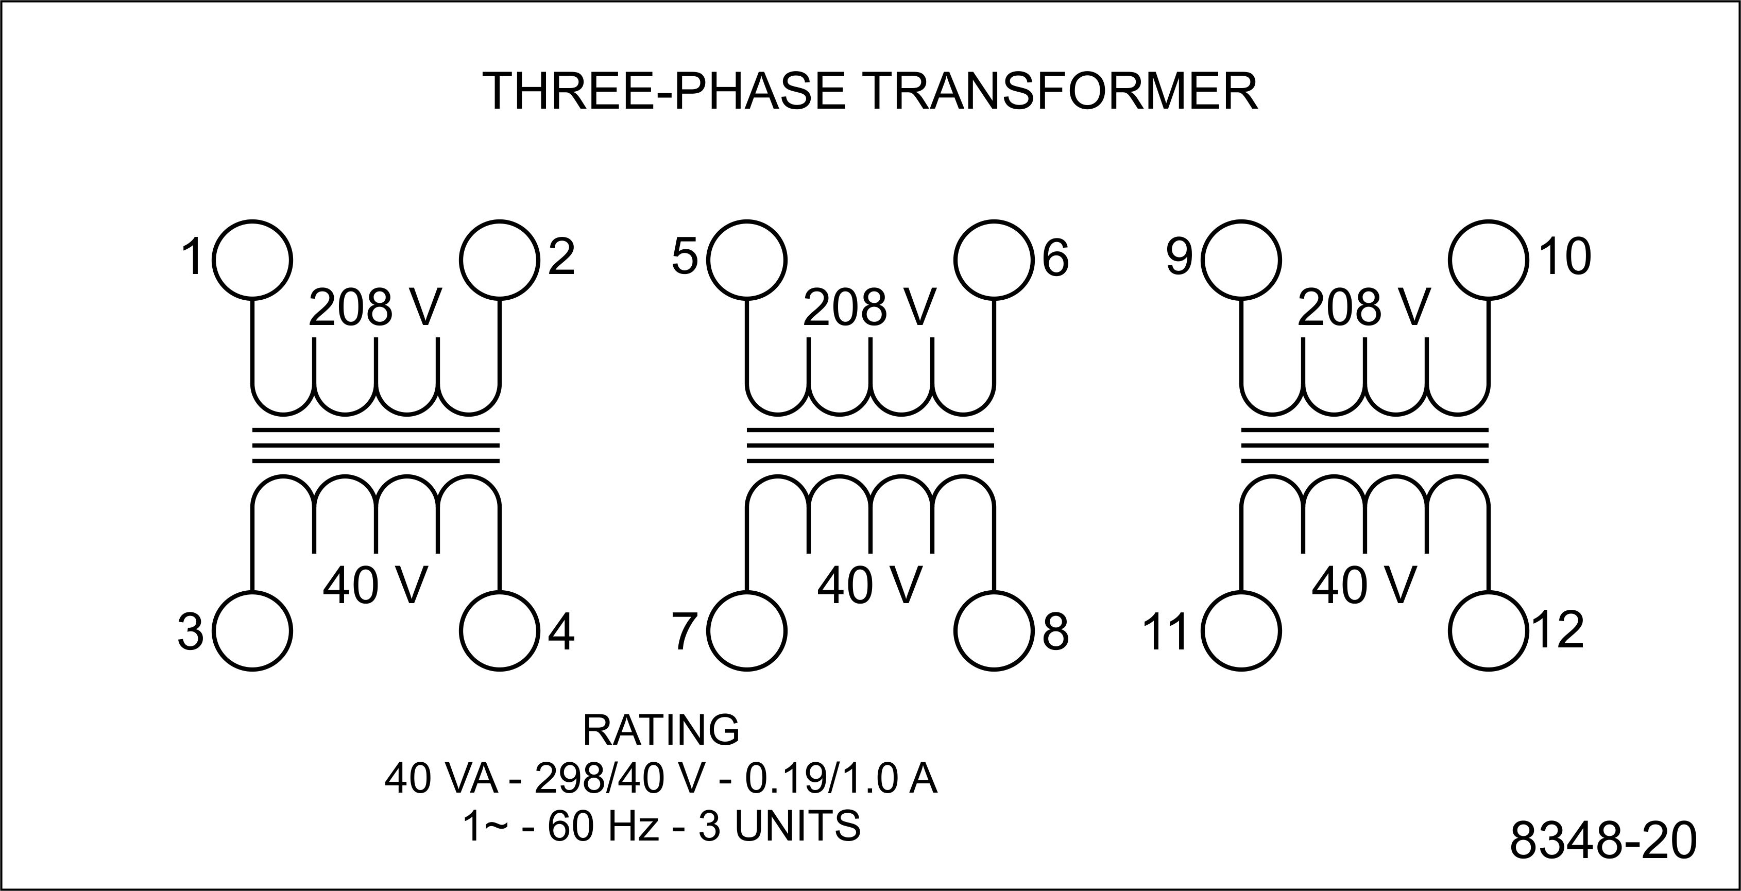
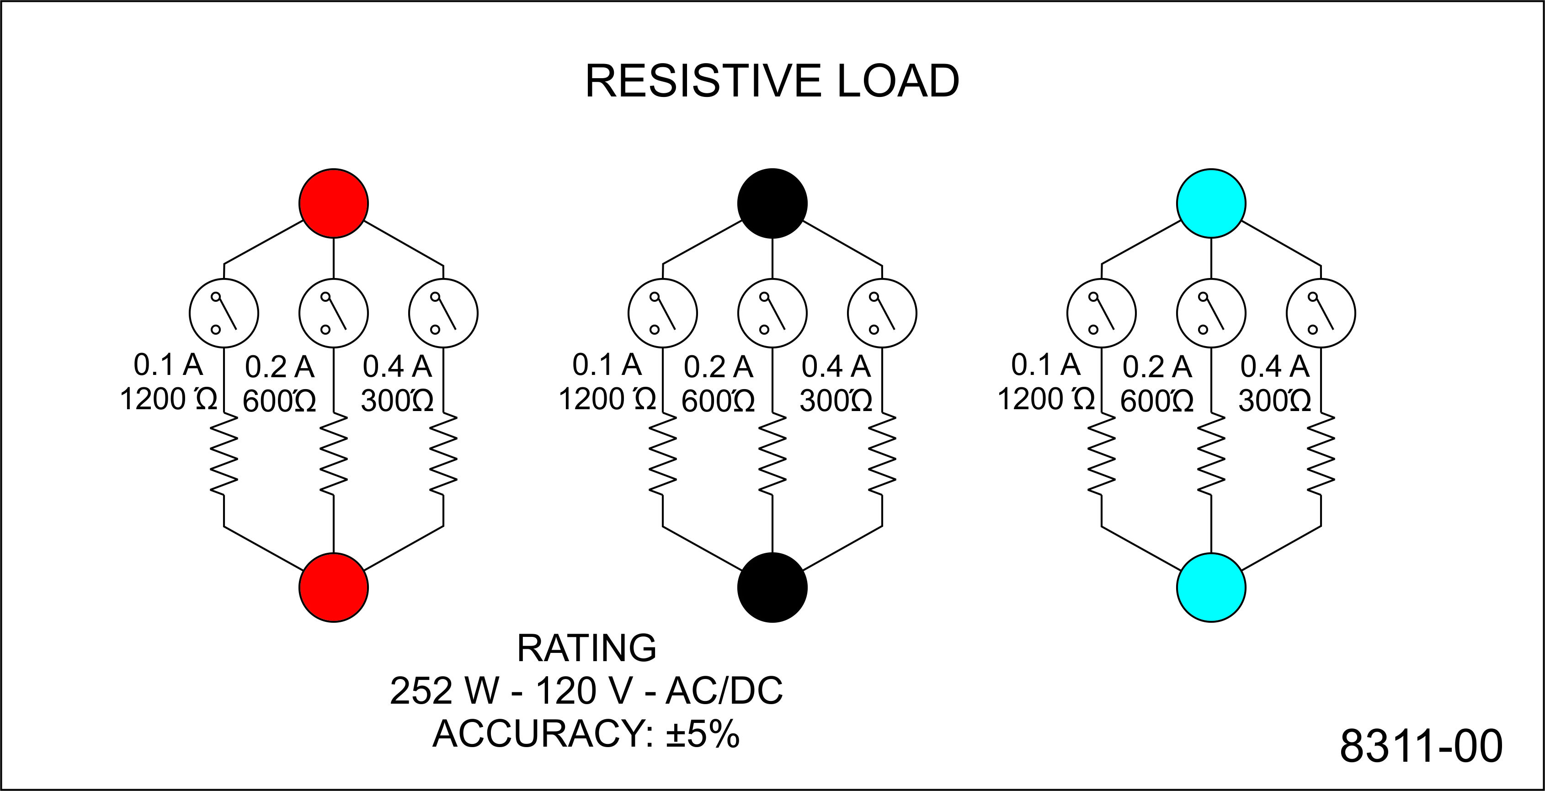
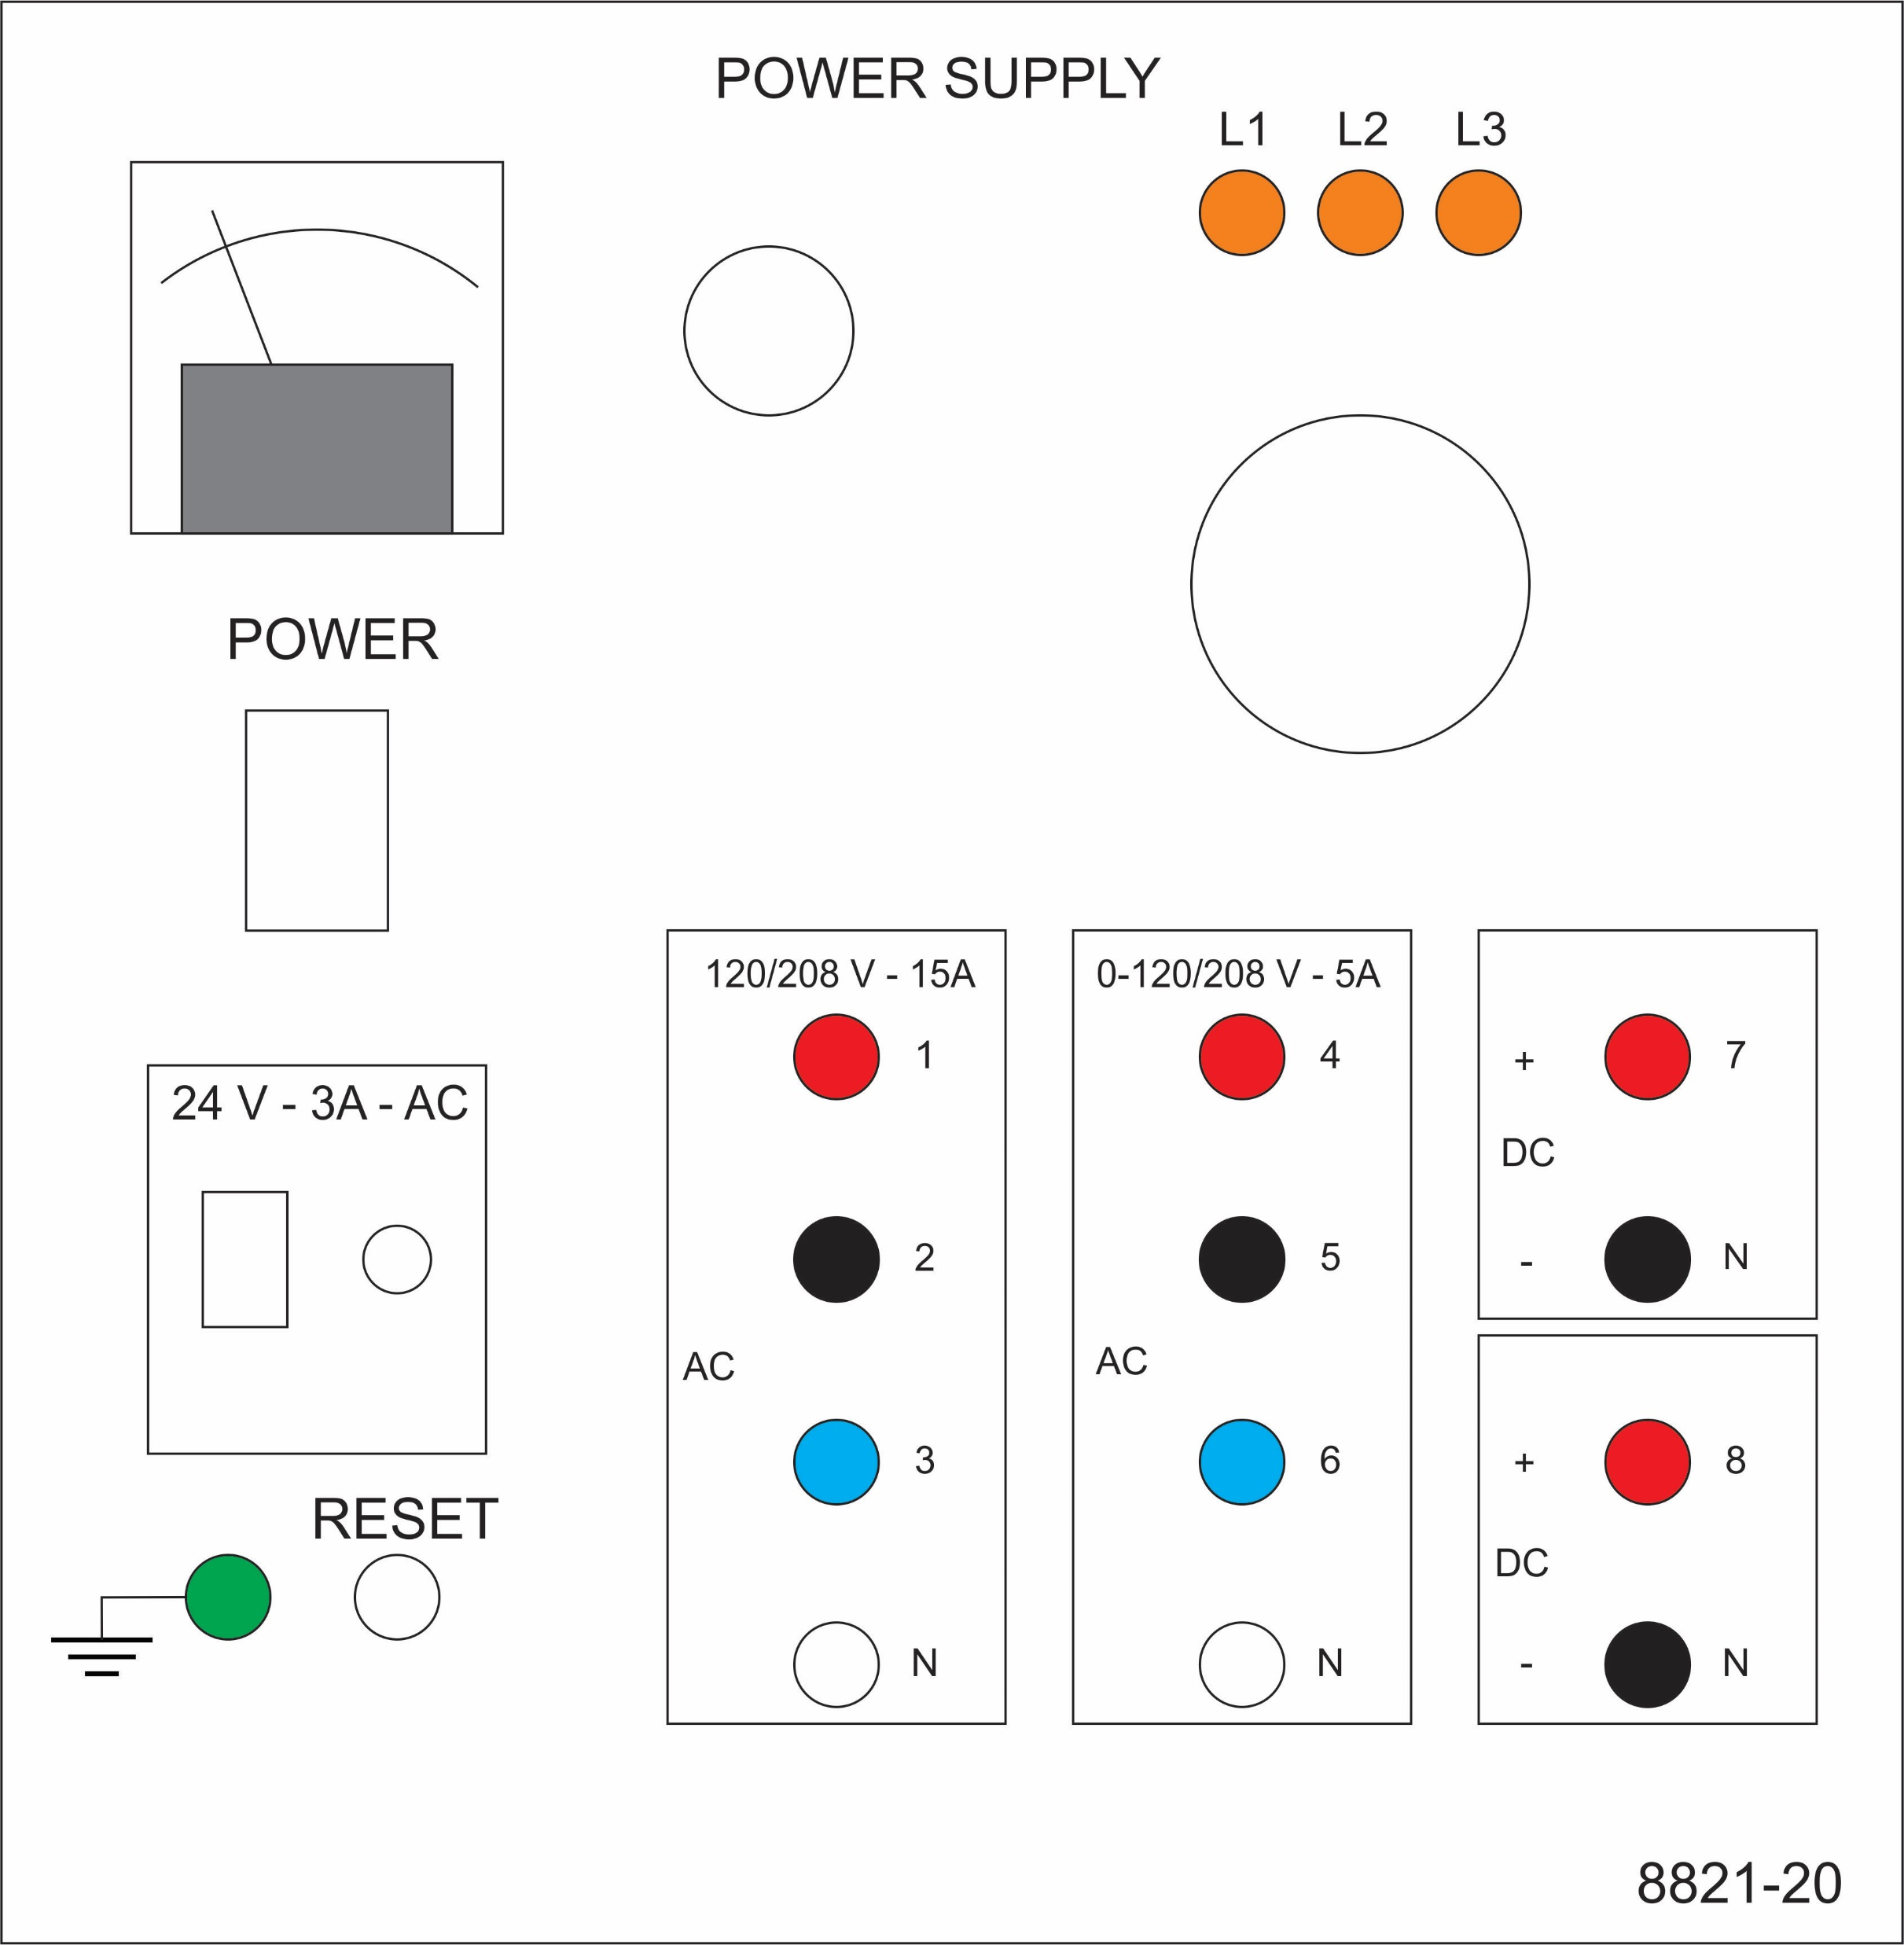
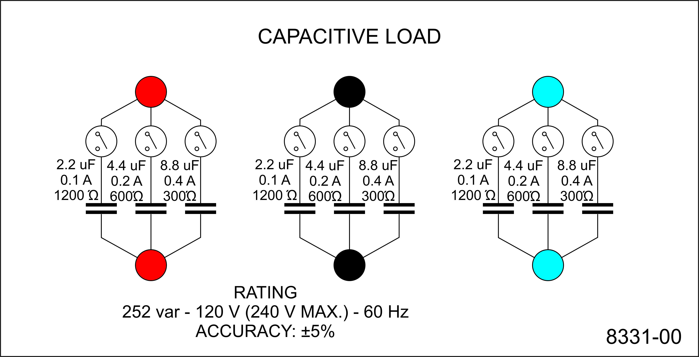
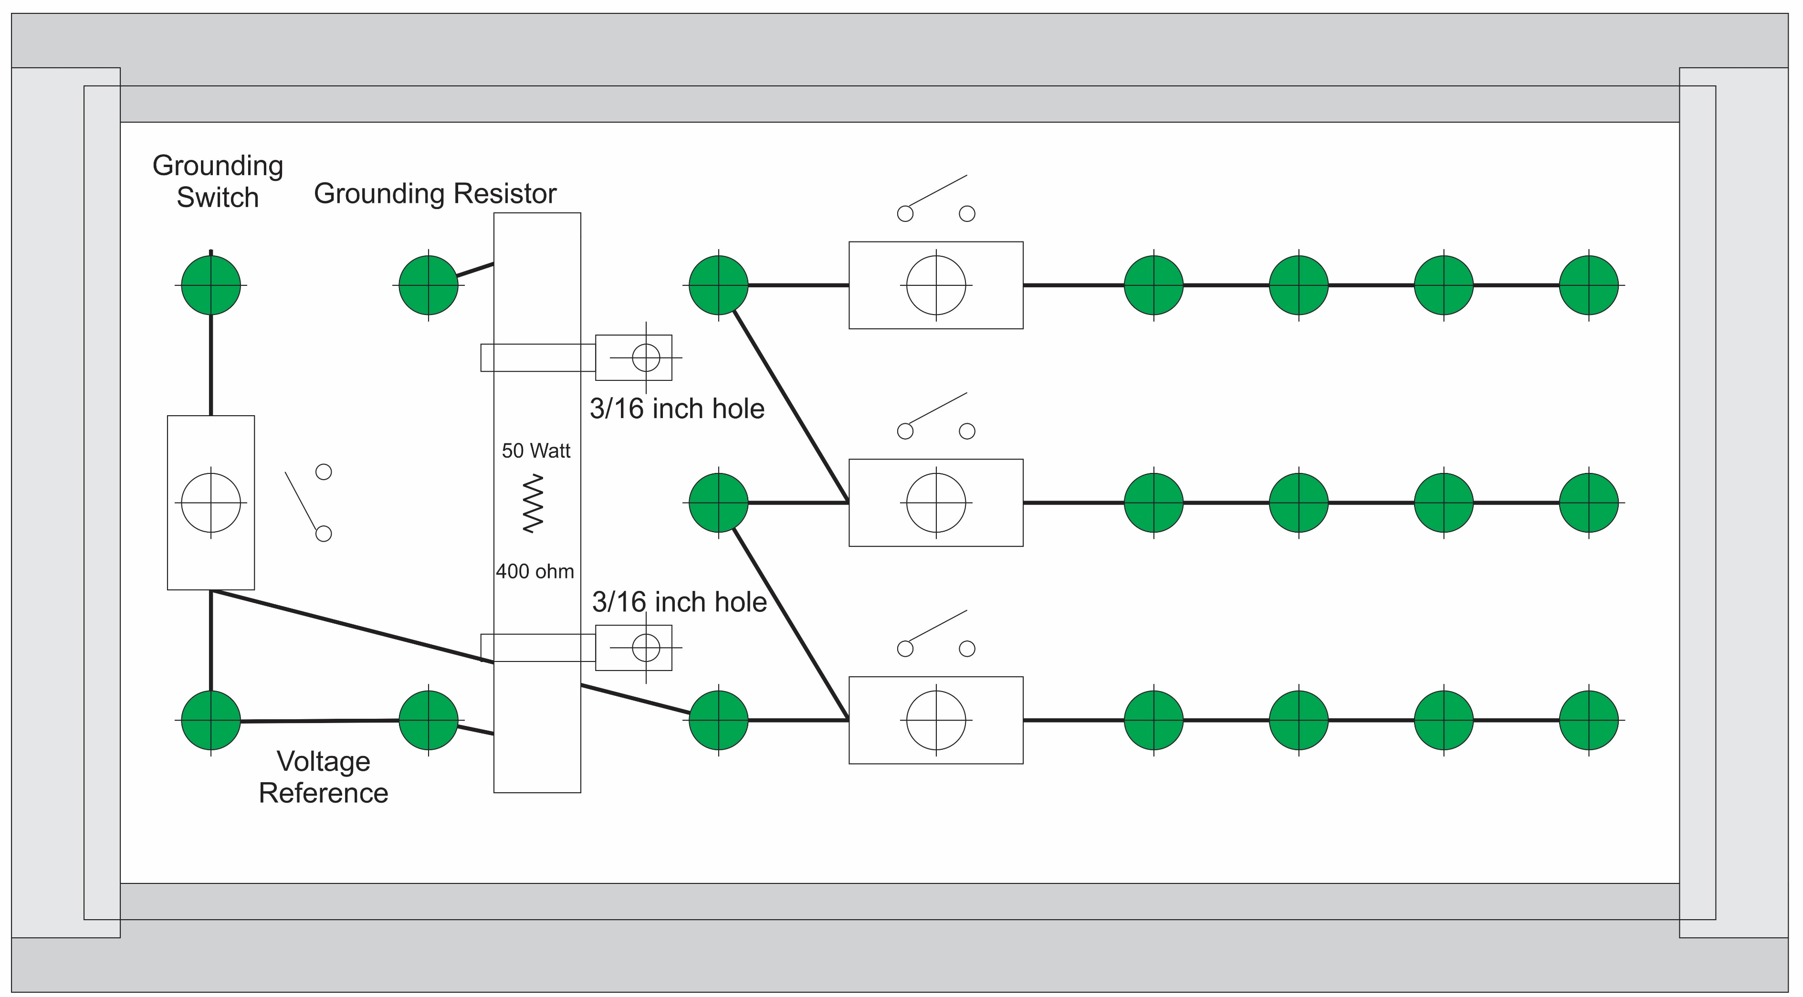
Experiment 14
Secondary - LL
Secondary - LN
Secondary - LG
Load line
Wye
Delta-Load
Parasitic

Slide 4
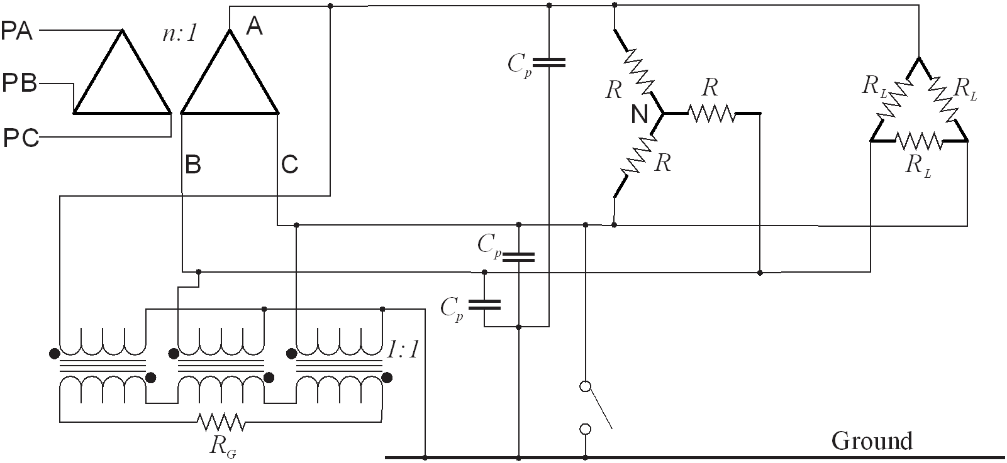

Simulation Model
LTspice
20241110 experiment 14.asc

Slide 5
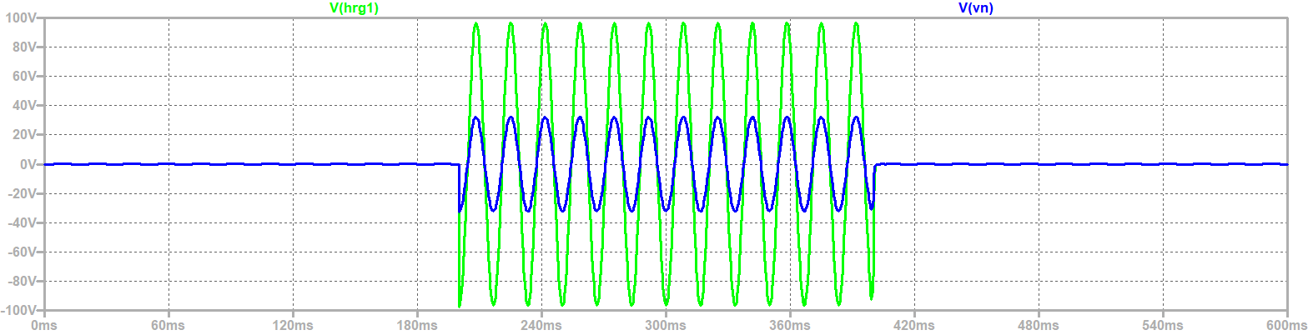
Neutral to ground voltage
HRG resistor voltage – HRG resistor to neutral voltage
Neutral to Ground Voltage and HRG to ground voltage

Slide 6
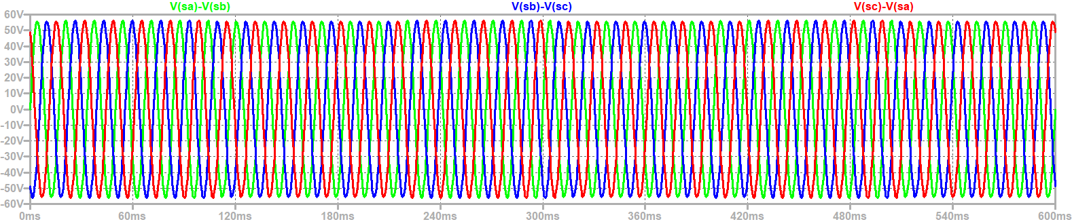
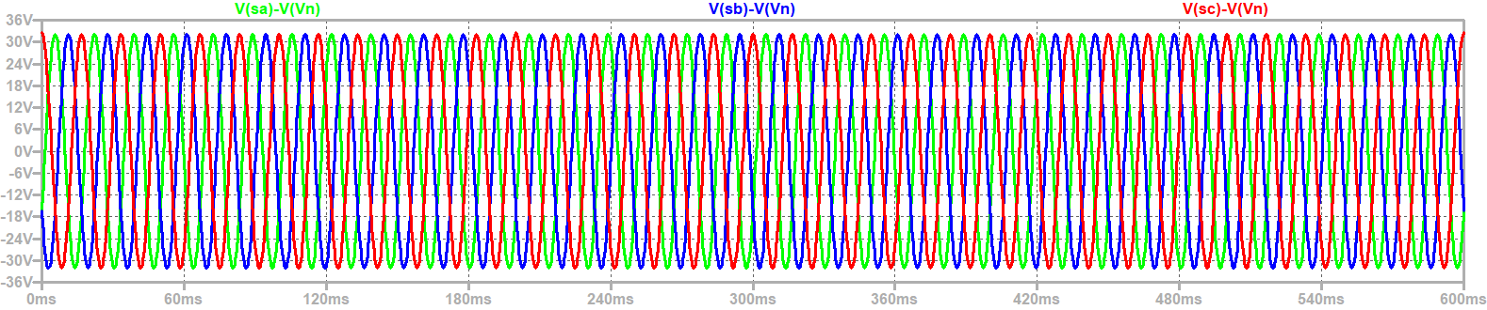
Steady State Voltages
Line to line voltage
Line to neutral voltage
Ground Fault

Slide 7
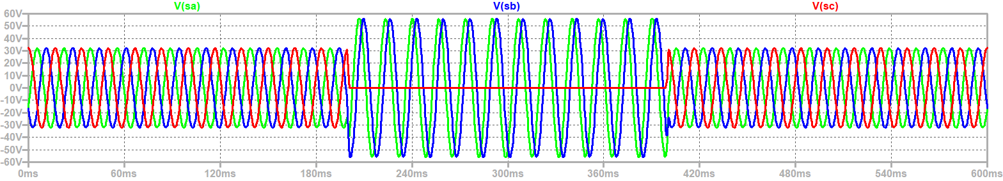
Steady State line to ground Voltages

Slide 8
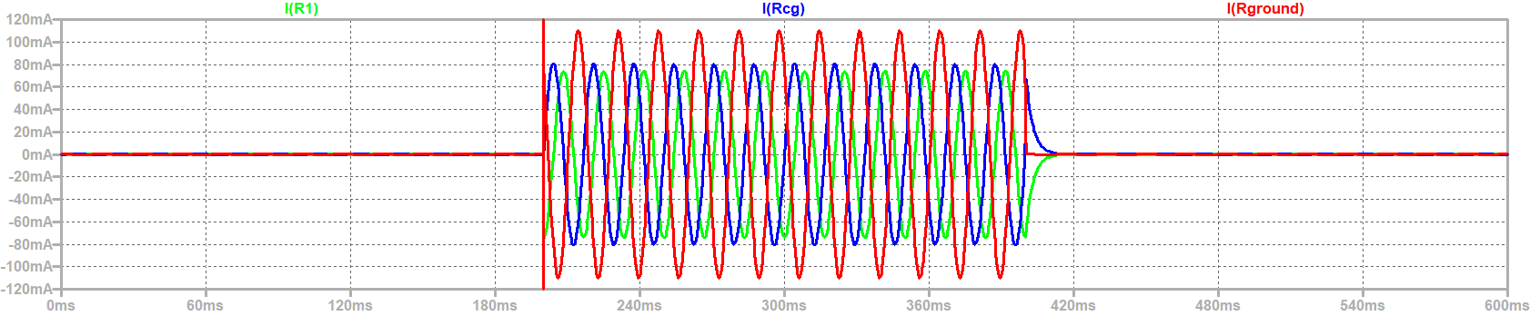
Wye winding current, Parasitic Capacitance ground current, and fault current

Slide 9
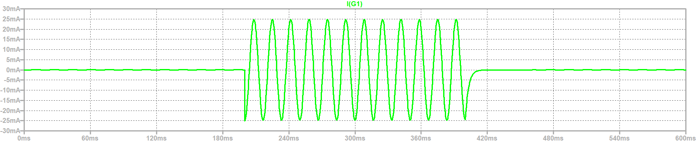
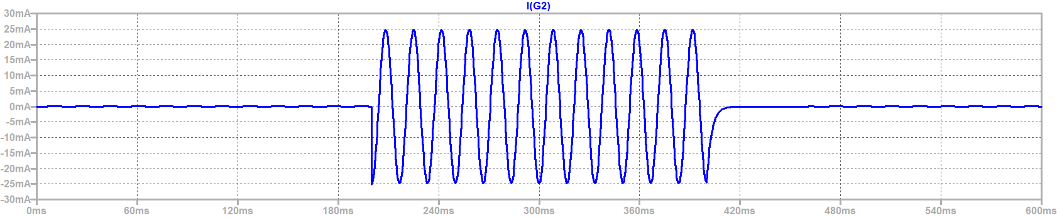
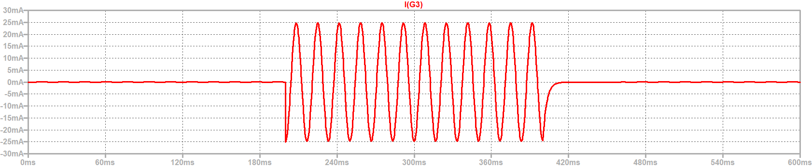
Current in grounding transformer

Slide 10
Wrap Up

